Slide 1
STAT 371 Project: What affects the government debt of a country?
By: Aryaman Bharath and Dan Ho

Slide 2
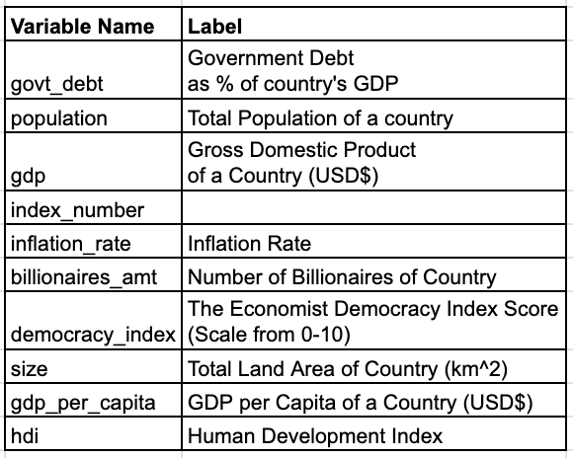
Goal
Analyse what factors and metrics influence a country’s government debt
Start Model: govt_debt ~ population + gdp + inflation_rate+ billionaires_amt + democracy_index + size + gdp_per_capita + hdi

Slide 3
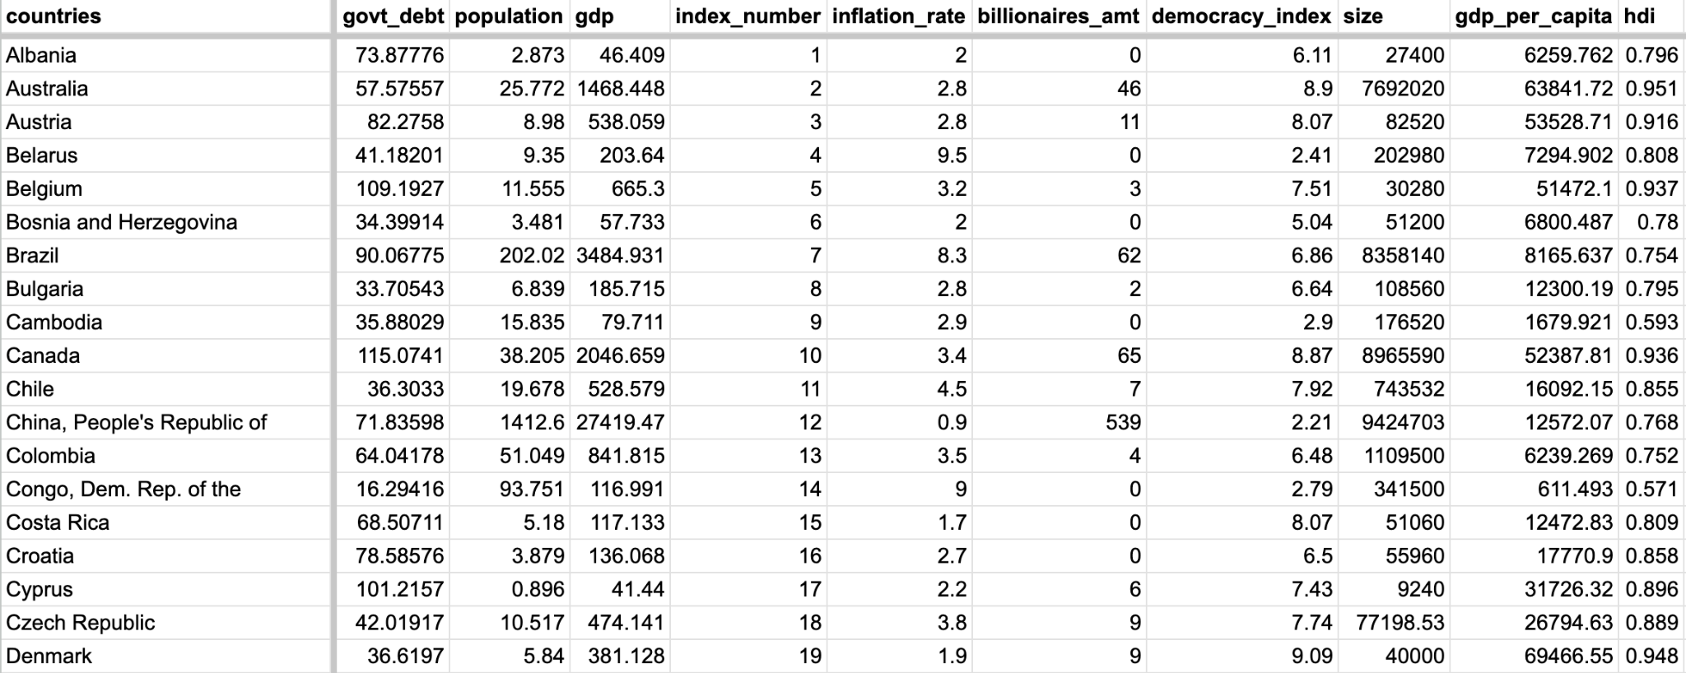
Sample Data

Slide 4
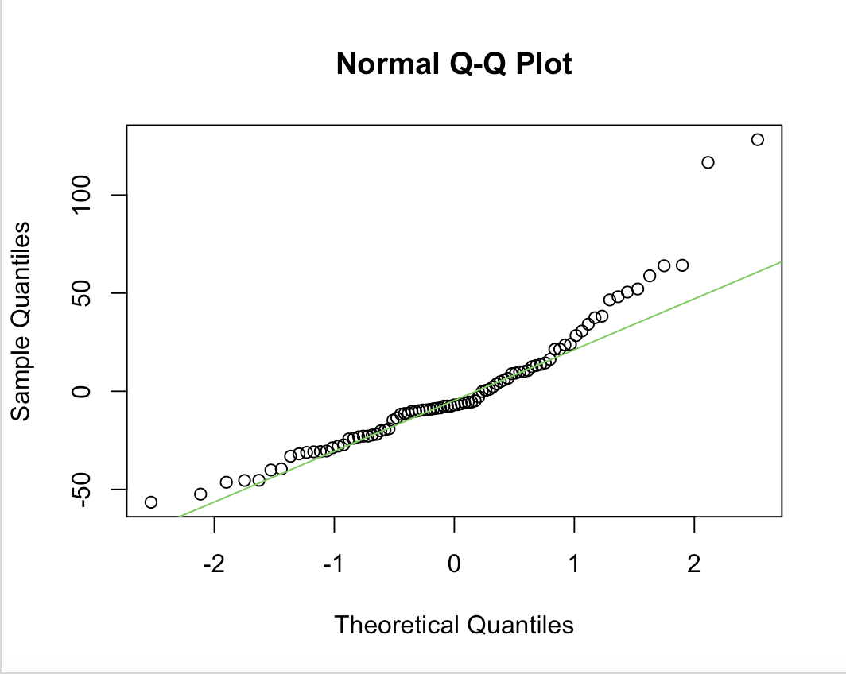
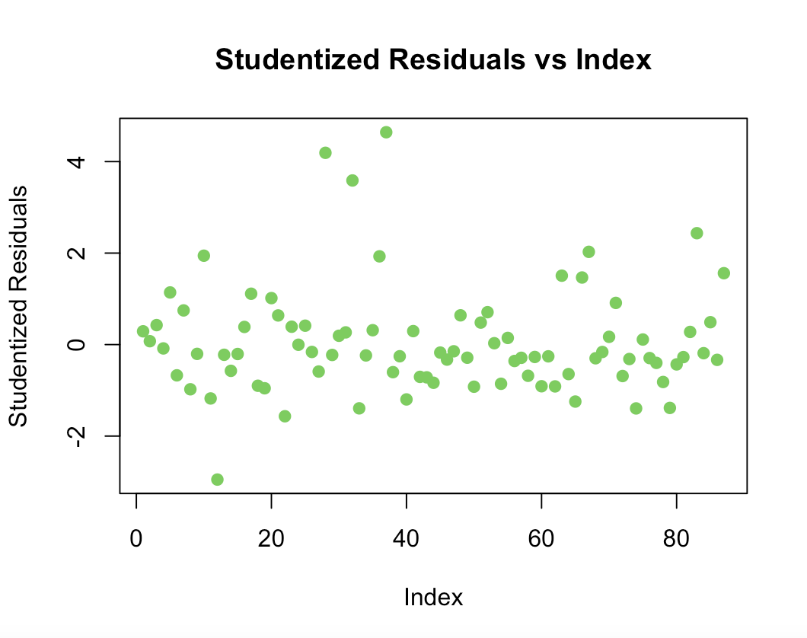
Diagnostics Test #1

Slide 5
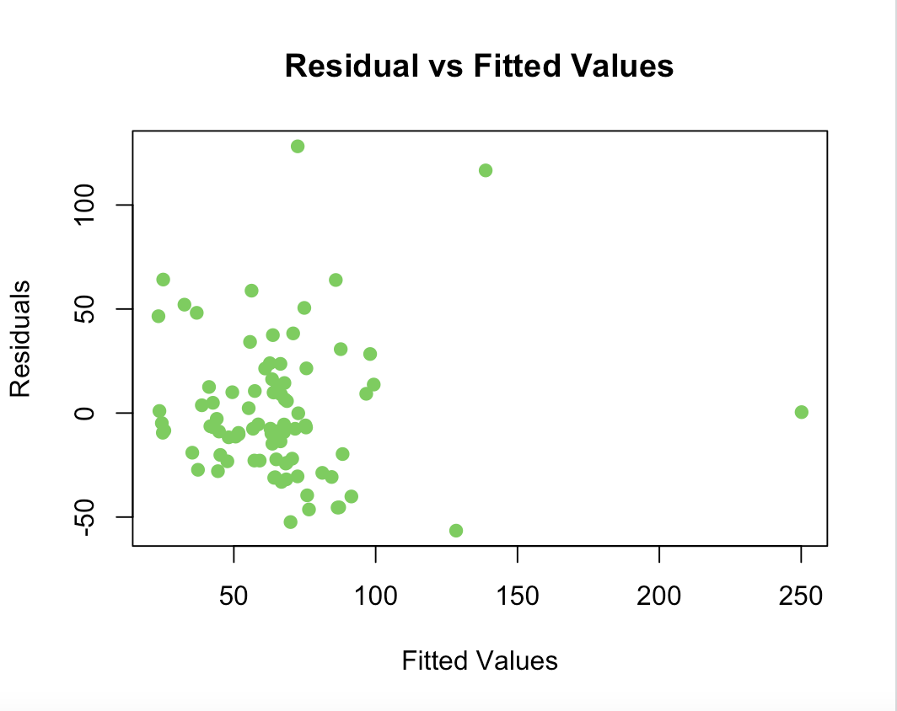
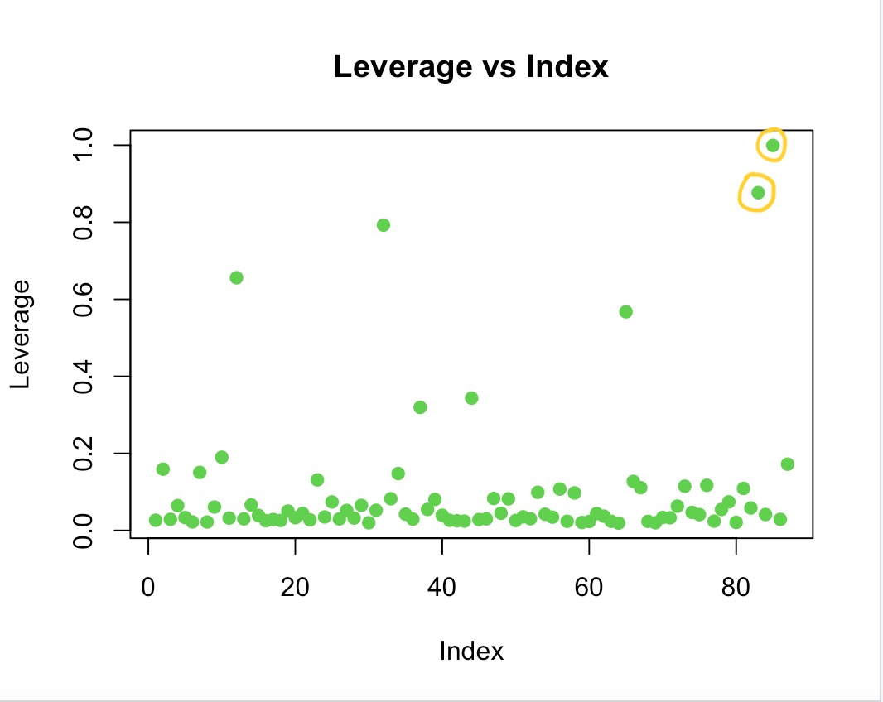
Diagnostics Test #1

Slide 6
Model Transformation
New model:
log(govt_debt) ~ population + gdp + inflation_rate + billionaires_amt + democracy_index + size + gdp_per_capita + hdi

Slide 7
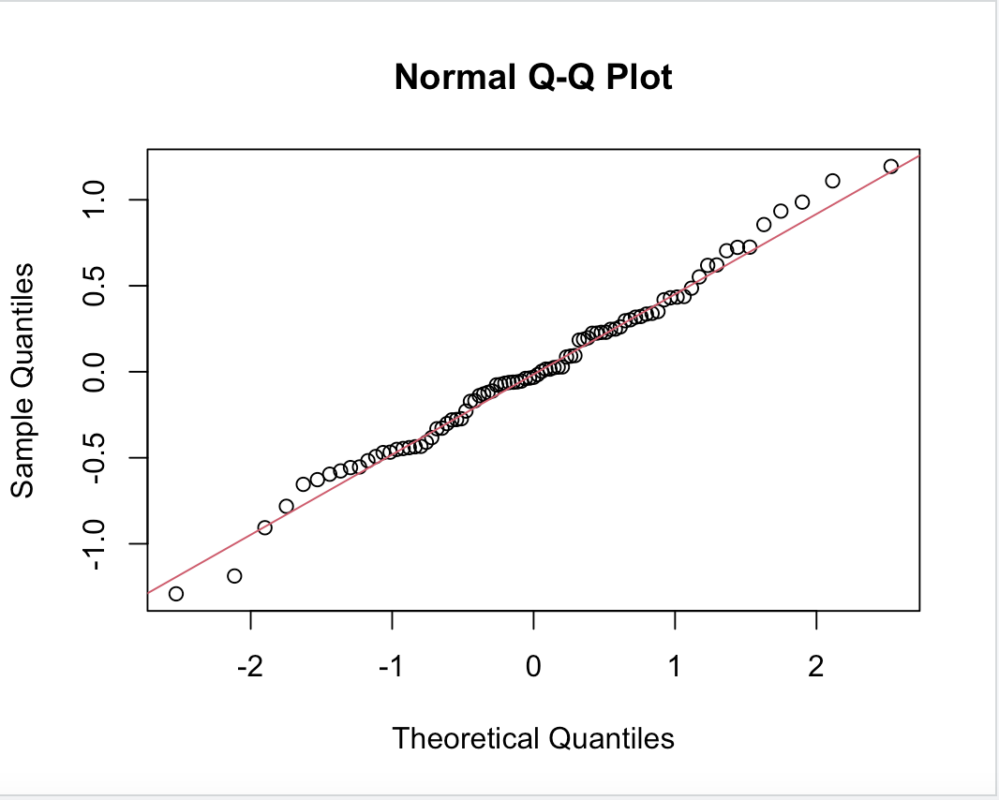
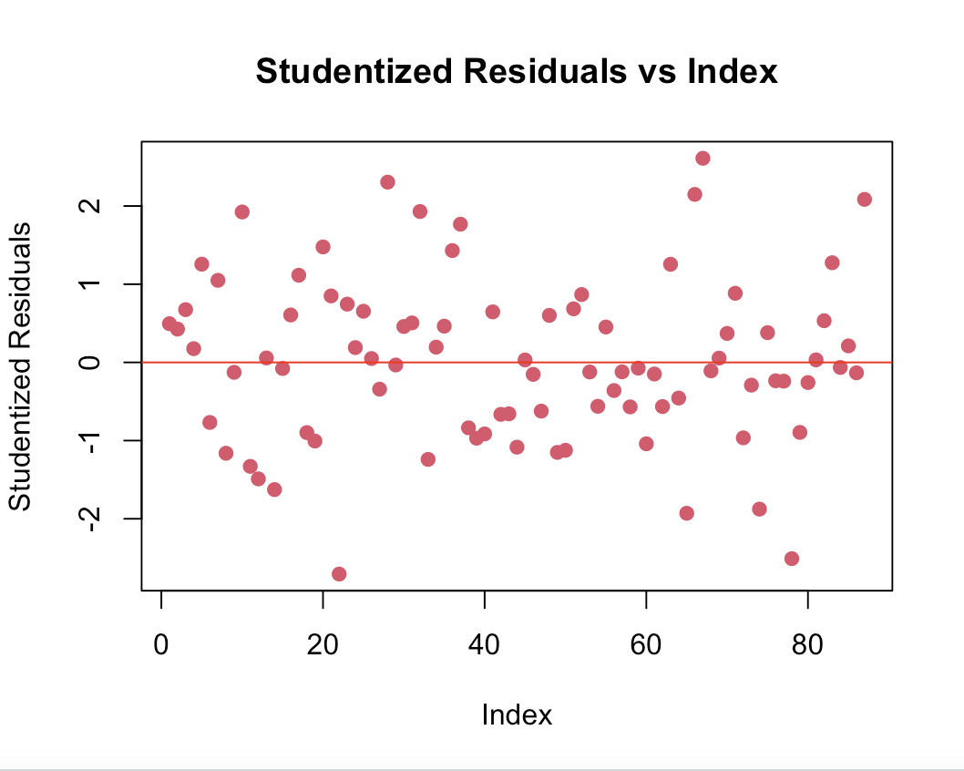
Diagnostics Test #2 using log(govt_debt)

Slide 8
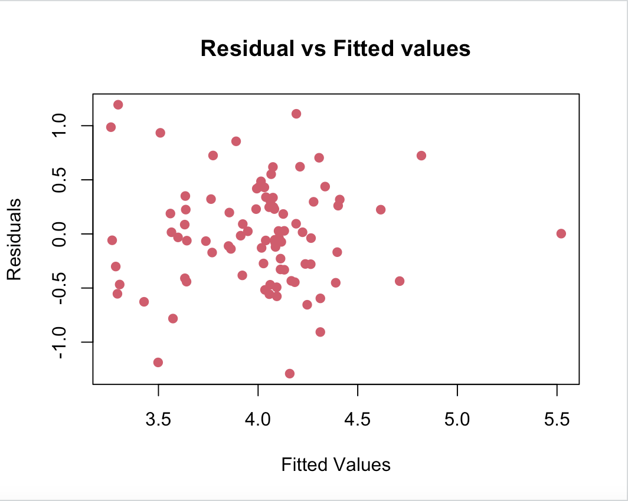
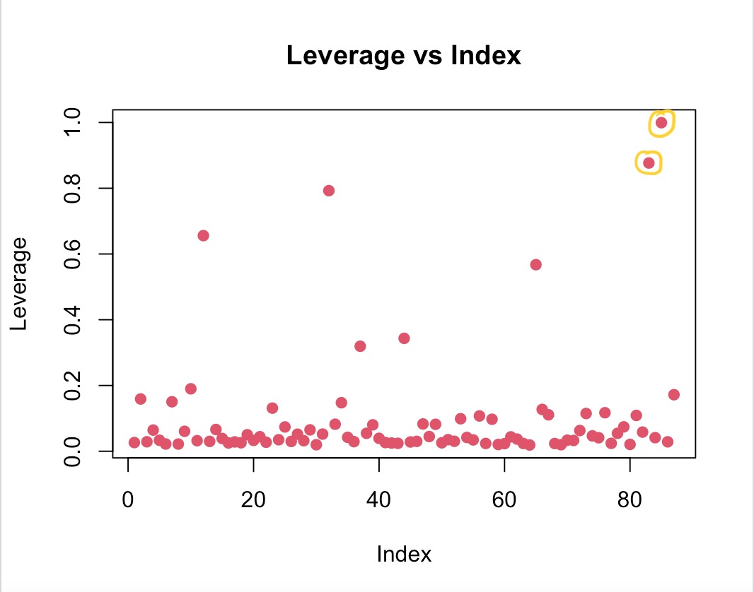
Diagnostics Test #2 using log(govt_debt)

Slide 9

Points of High Leverage
Index number 85 and 83 correspond to Venezuela and USA respectively

Slide 10
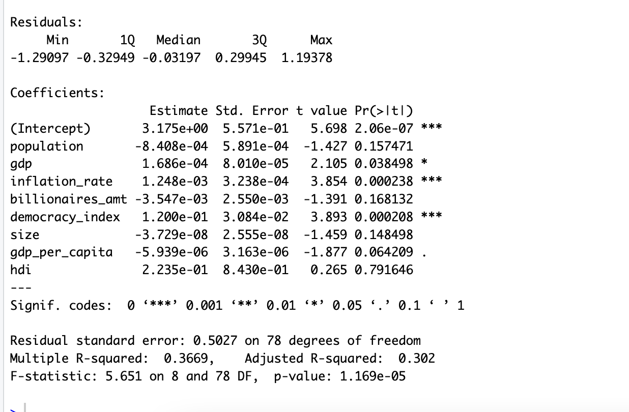
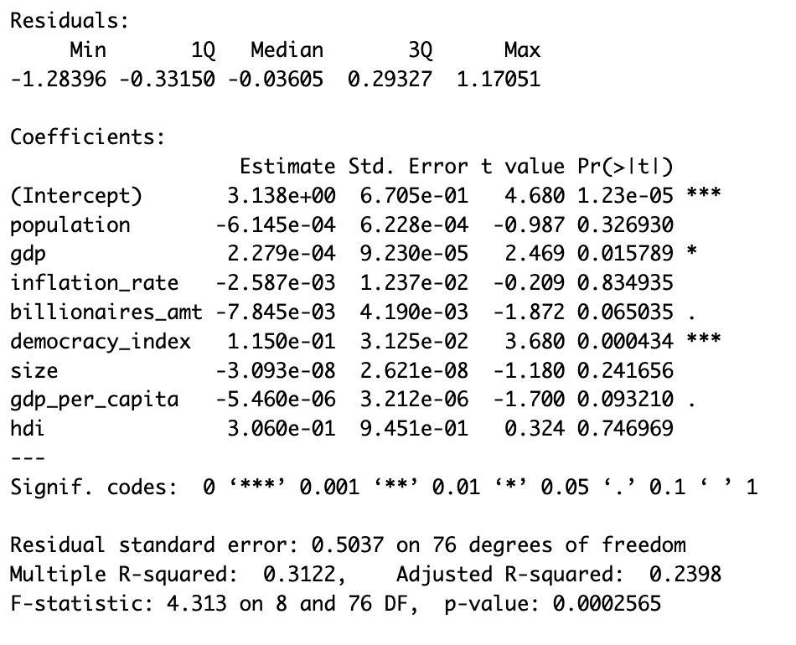
Regression after removing points of high leverage
Kept points of high leverage
Removed points of high leverage

Slide 11
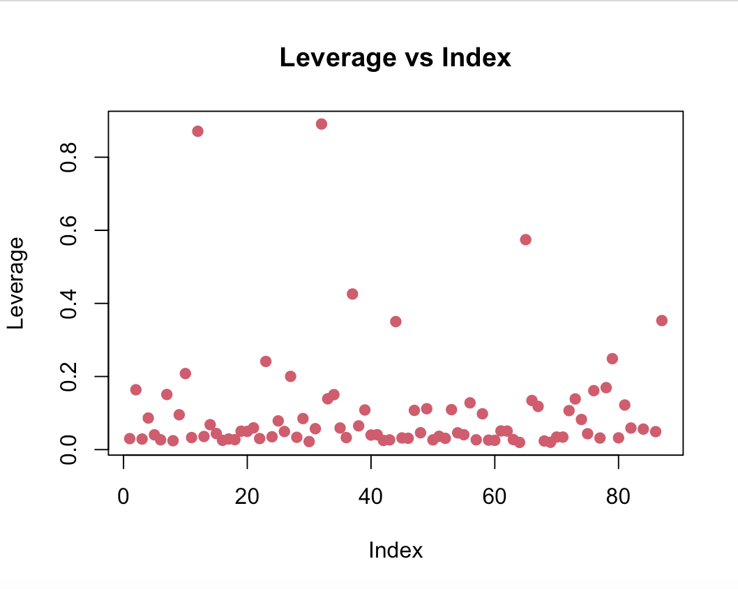
Diagnostics Test #3 (Removing points of high leverage)

Slide 12
What model to use ?
Backward selection
2)log(govt_debt) ~ population + gdp + index_number + billionaires_amt + democracy_index + size + gdp_per_capita + hdi
AIC=-108.7
1)log(govt_debt) ~ population + gdp + index_number + inflation_rate + billionaires_amt + democracy_index + size + gdp_per_capita + hdi
AIC=-106.7
5)log(govt_debt) ~ population + gdp + billionaires_amt + democracy_index + Gdp_per_capita
AIC=-112.17
Final model: log(govt_debt) ~ gdp + billionaires_amt + democracy_index + gdp_per_capita
Step: AIC=-112.55
4)log(govt_debt) ~ population + gdp + billionaires_amt + democracy_index + size + gdp_per_capita
AIC=-111.82
3)log(govt_debt) ~ population + gdp + index_number + billionaires_amt + democracy_index + size + gdp_per_capita
AIC=-110.43
Notes:
Start with initial model where all of the x-variable such as population, gdp, index number, inflation rate, number of billionaires, democracy index + size + gdp per capita +
Human index is included in the model with the AIC of -106
Then I remove inflation rate, then HDI, index number, size and finally population. And our final model using backward selection is
log(govt_debt) ~ gdp + billionaires_amt + democracy_index + gdp_per_capita

Slide 13
What model to use ?
forward selection
Start: AIC=-92.28
log(govt_debt) ~ 1
Step1: AIC=-106.85
log(govt_debt) ~ democracy_index
Step3: AIC=-112.27
log(govt_debt) ~ democracy_index + gdp + billionaires_amt
Step4: AIC=-112.55
log(govt_debt) ~ democracy_index + gdp + billionaires_amt + gdp_per_capita
Final model: log(govt_debt) ~ gdp + billionaires_amt + democracy_index + gdp_per_capita
Step: AIC=-112.55
Step2: AIC=-108.67
log(govt_debt) ~ democracy_index + gdp
Notes:
Start with initial model where all of the x-variable such as population, gdp, index number, inflation rate, number of billionaires, democracy index + size + gdp per capita +
Human index is included in the model with the AIC of -106
Then I remove inflation rate, then HDI, index number, size and finally population. And our final model using backward selection is
log(govt_debt) ~ gdp + billionaires_amt + democracy_index + gdp_per_capita

Slide 14
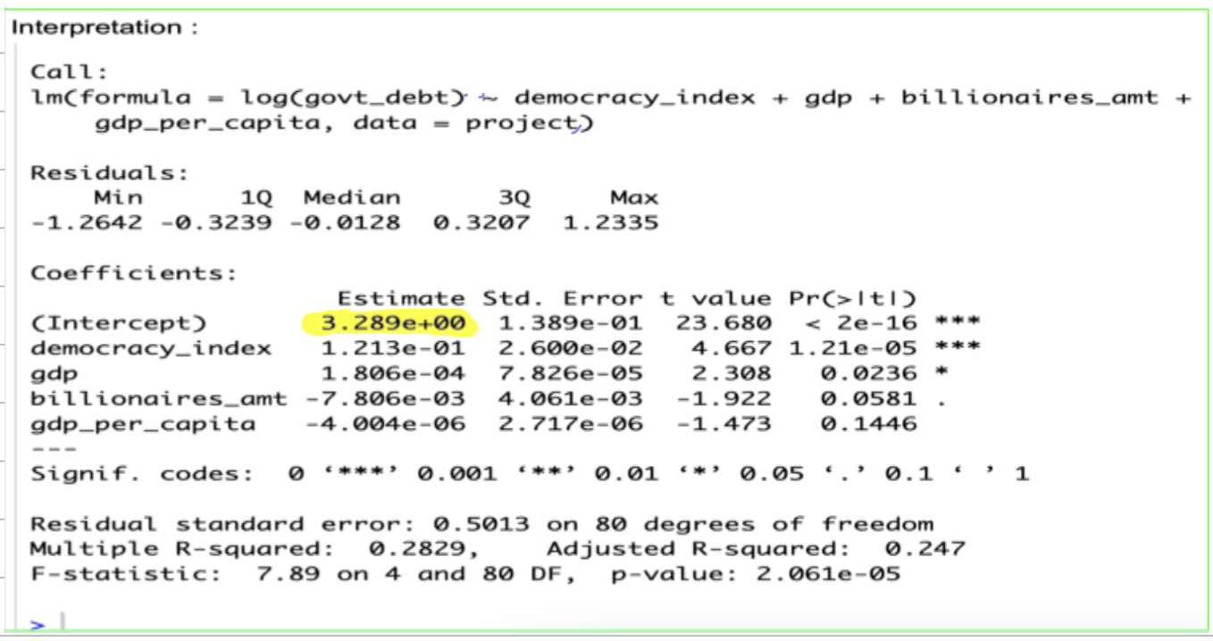
Interpretation - intercept

Slide 15
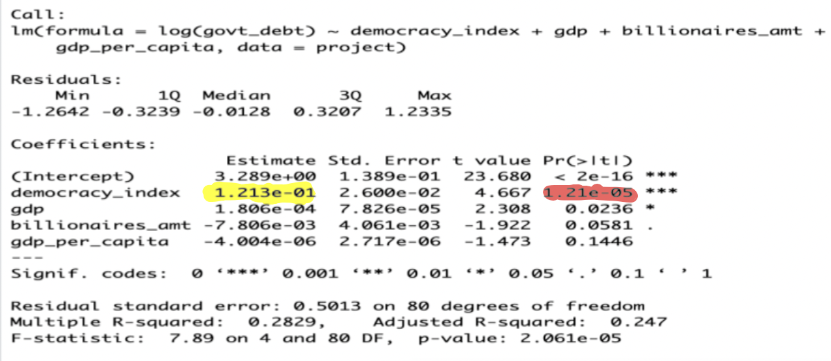
Interpretation - Democracy Index

Slide 16
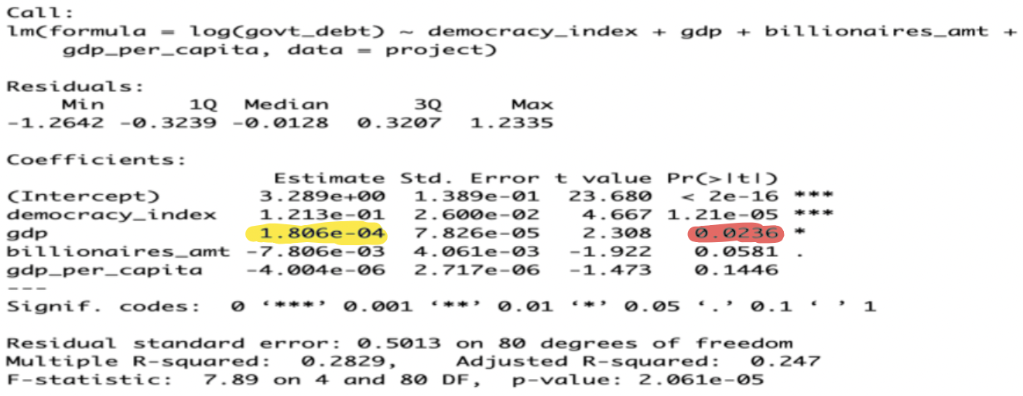
Interpretation - GDP

Slide 17
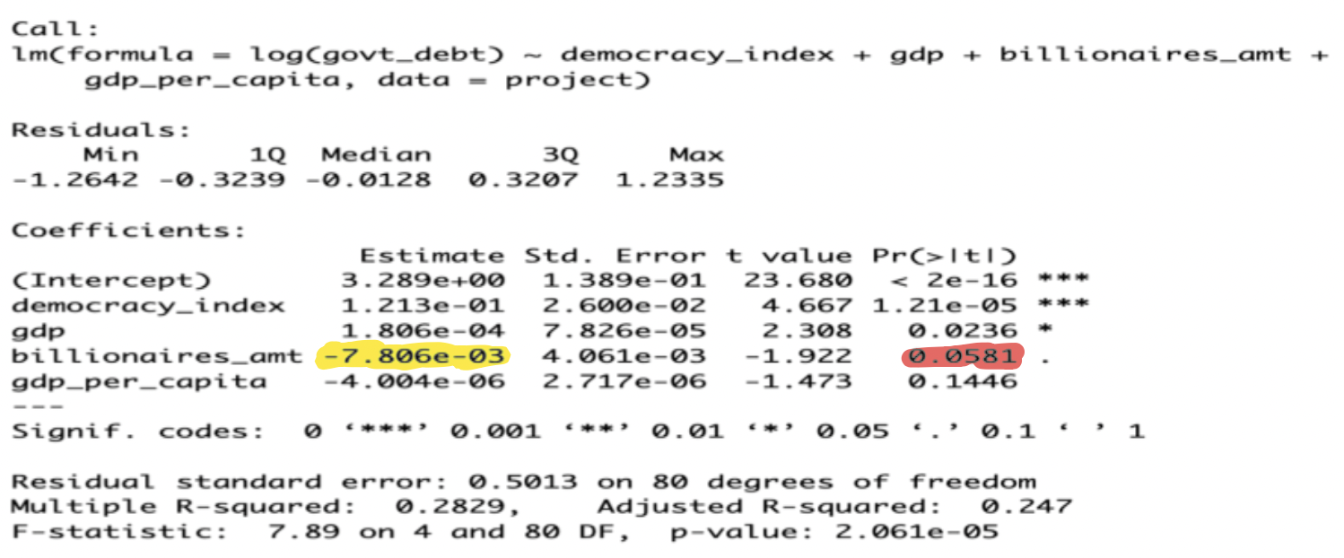
Interpretation - Number Of Billionaires

Slide 18
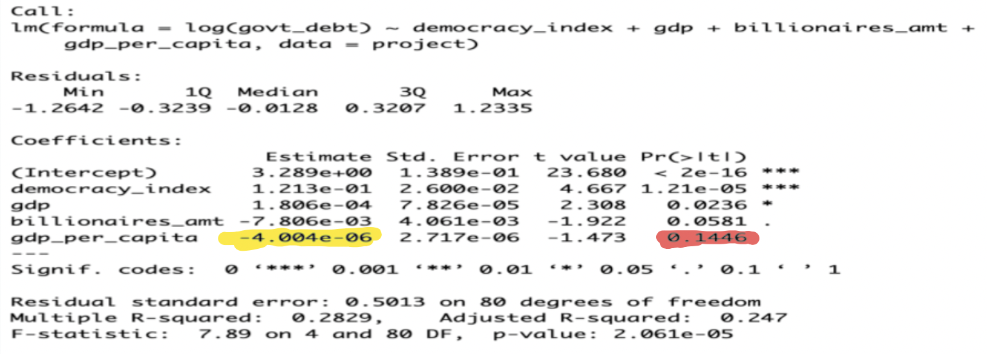
Interpretation - GDP Per Capita

Slide 19
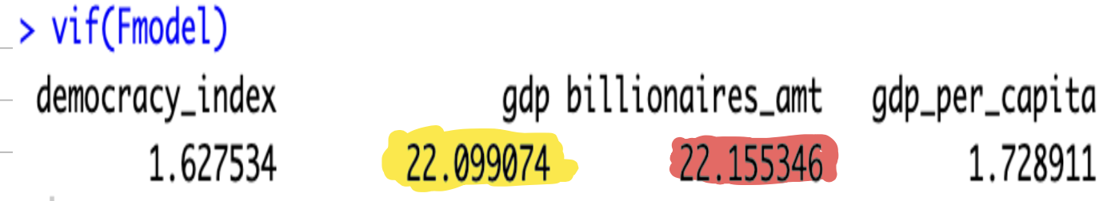
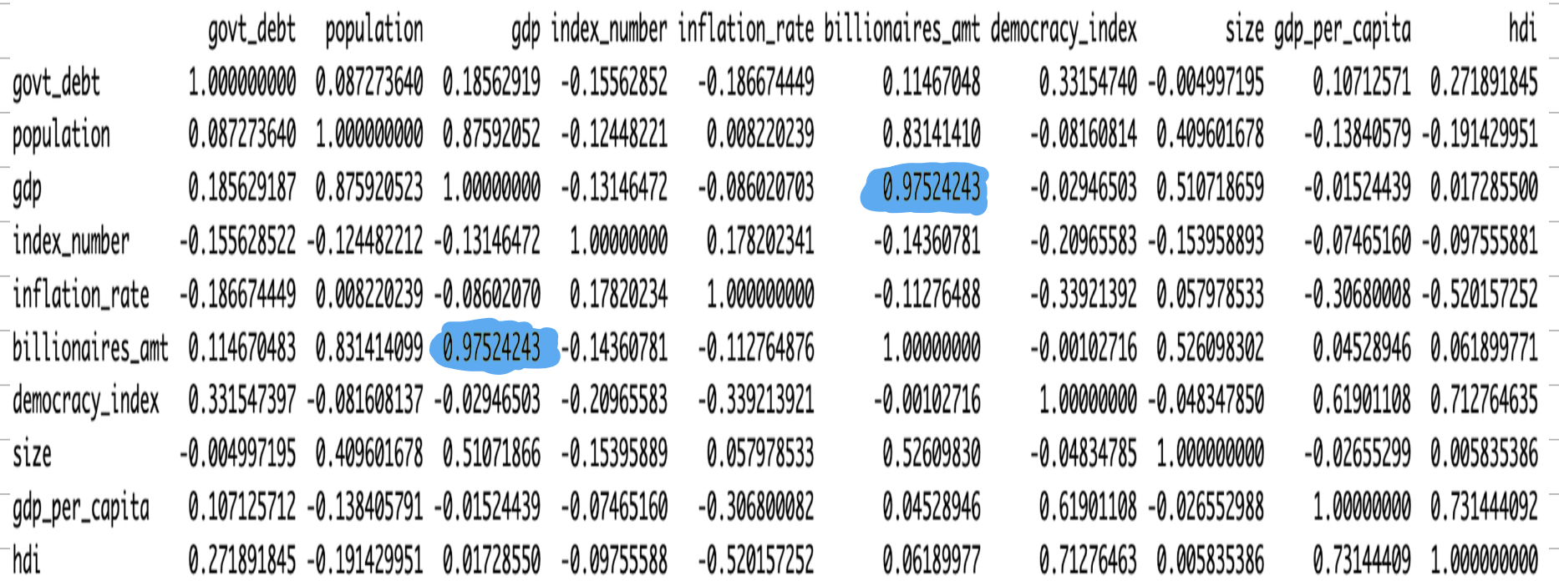
VIF

Slide 20
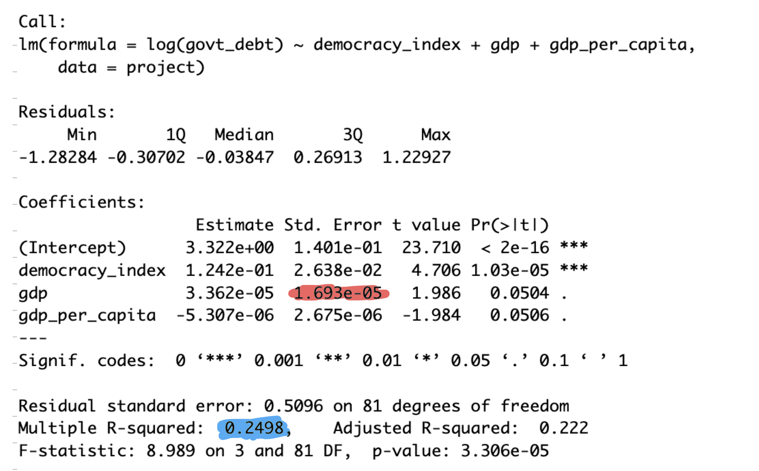
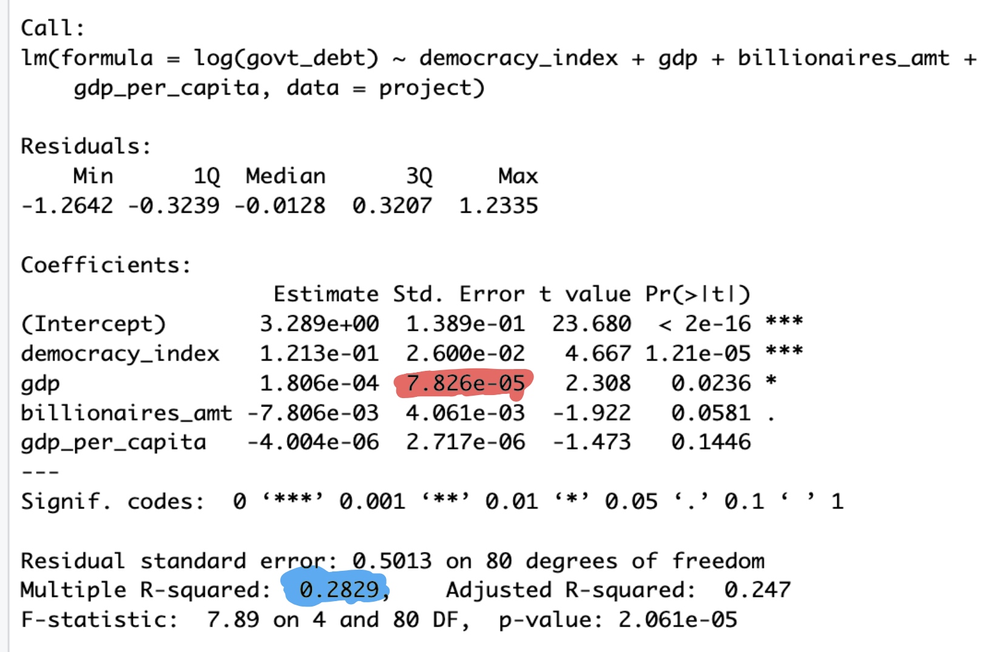
VIF
Removing Billionaires
Keep Billionaires

Slide 21
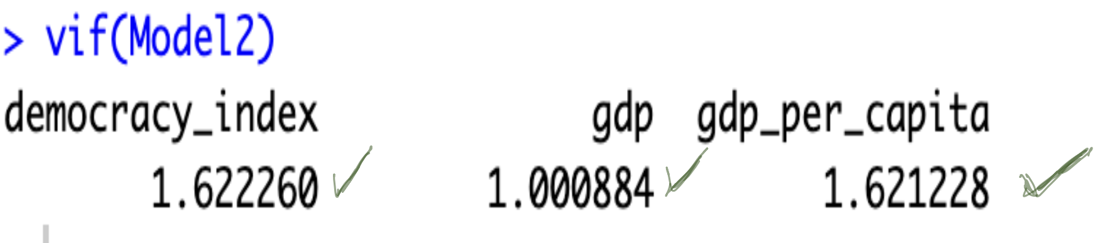
VIF

Slide 22
Hypothesis Test
democracy_index was the most statistically significant, we wanted also to investigate what happens to government debt if one unit increase in democracy index will lead to 1% increase in Government debt
We are testing at alpha = 0.05
Null hypothesis (H0): The coefficient of democracy_index equals 1.
Alternate Hypothesis (H1): The coefficient of democracy_index is not equal to 1.

Slide 23
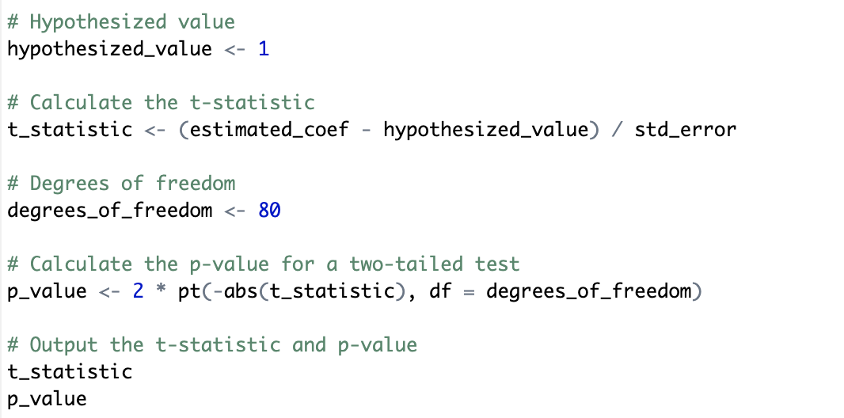
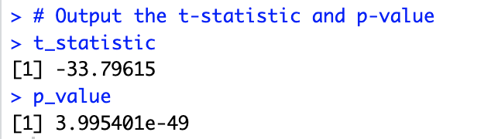
Hypothesis Test Results
Hence, since the p-value of 3.995 x 10-49 is less alpha = 0.05, we would reject the null hypothesis (H0) and conclude that there is evidence to suggest the coefficient for democracy_index is not equal 1.

Slide 24
Conclusion
Final model: log(govt_debt) ~ democracy_index + gdp +gdp_per_capita
Multiple R-squared: 24.98%
Democracy index

Slide 25


